Slide 1
Programmer Homepage
For ideal window management tool for any and all programmers needs

Slide 3
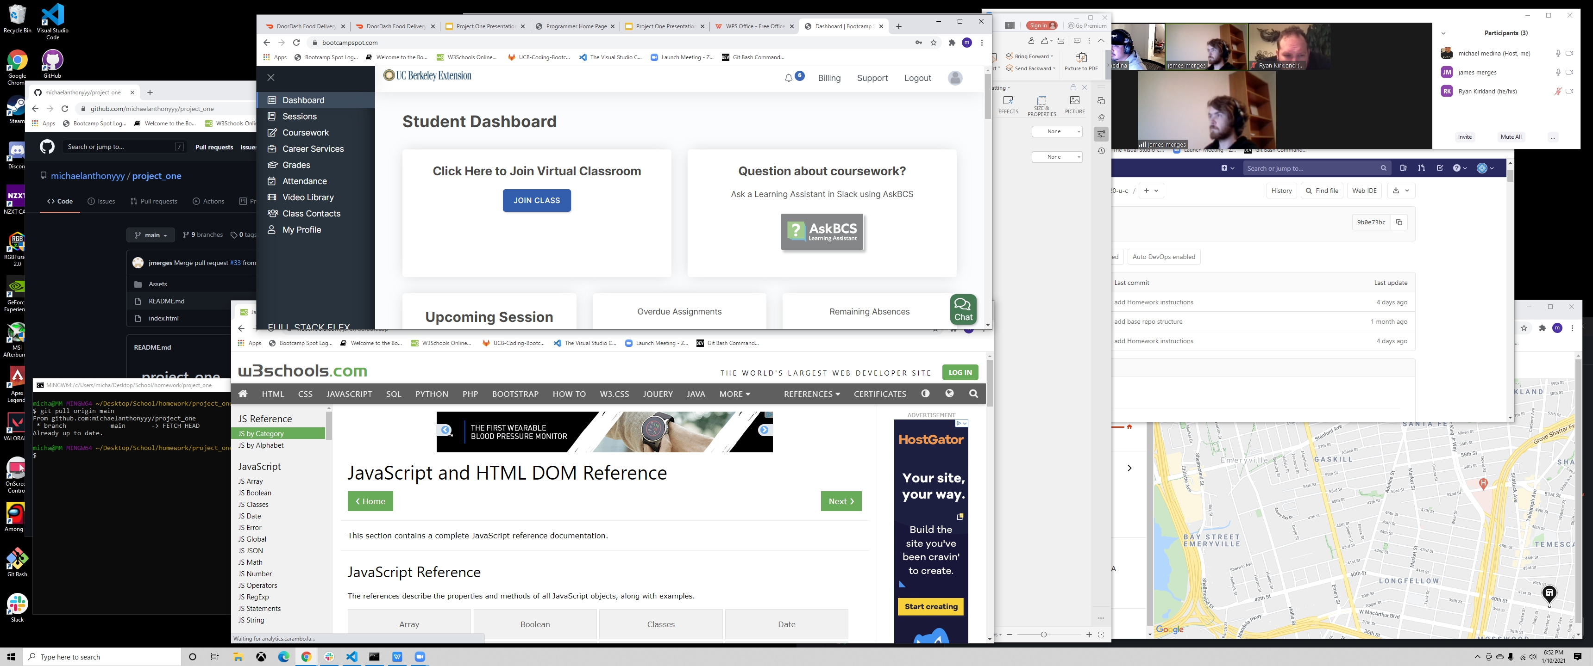
Why Make It?
One of the biggest problems we can run into as programming students is window or tab management for a browser. We wanted to address this problem by creating a central page where all these windows and tabs can be taken care of or accessed within one centralized location.
Research you did:
Into existing apps
how is this different
how is this the same?

Slide 4
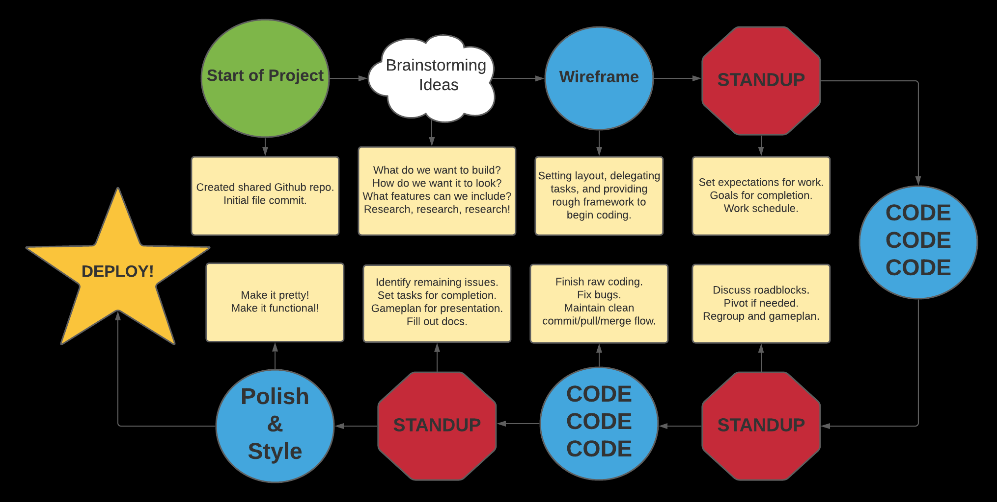
Design Process
The first step we took in the design process was pitching ideas back-and- forth about ideas we had about what we wanted to do. From there we came up with an outline and worked icremenetally piece-by-piece through each section that we each suggested would be useful for our end goal.

Slide 5
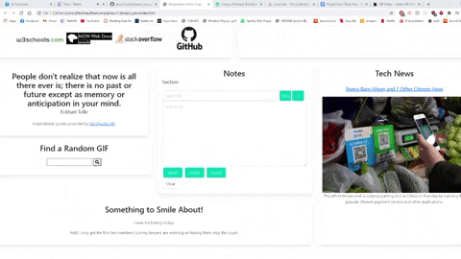
Design Process

Slide 6
Design Process
Planning Wireframe
Side by Side of initial Wireframe vs. end product

Slide 7
Team Process
Task Breakdowns
Images of:
User Stories
Github Issues
Github Project Cards
Github Branches
Commits #

Slide 8
Team Process
James:
● Notes saved to local storage
● Tech News
● Clean-up of problem code
Ryan:
● Inspirational Quotes
● GIPHY search query
● Funny Jokes
Michael:
● Youtube playlist for programmers
● Updated 3-day forecast weather by user search
● Reference links for most utilized sites
Task Assignment

Slide 9
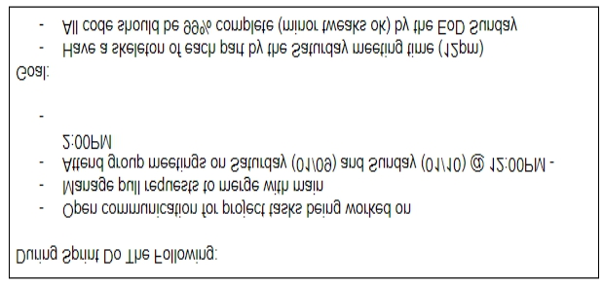
Team Process
Team workflow
Working Agreements
Stand-ups

Slide 10
Design Process
API Research
Code Snippets
One thing we pivoted on was google maps.api as it required additional 3rd party login credentials from users keeping it from being a mostly dynamically loaded web application

Slide 11
Code Highlights
The bulma.io framework works very similar to Bootstrap but the layout we chose was similar to this one using tiles. Similar to bootstrap using containers, these tiles had Ancestors > Parents > Children elements

Slide 12
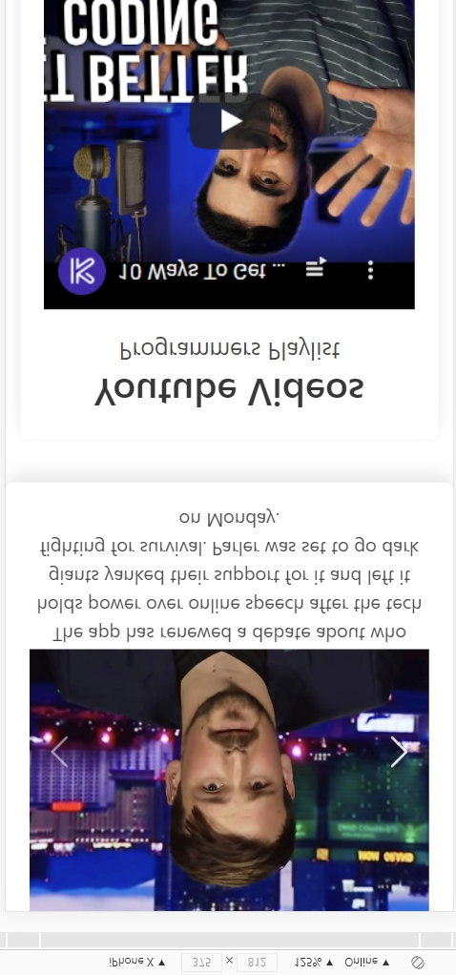
Code Highlights
One problem we ran into was having the embedded youtube video playlist size dynamically when the page is resized whether it was viewed on a mobile device or on desktop

Slide 13
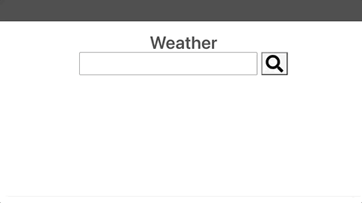
Code Highlights
The code for a 3-day weather forecase was completely written fresh to dynamically append each day to a specific column in the div. Icon’s for each weather type were also added for a nice aesthetic feel.
Gif of how it operates on site -> show us the working site

Slide 14
Code Highlights
jQuery.ajaxPrefilter(function (options) {
if (options.crossDomain && jQuery.support.cors) {
options.url = 'https://cors-anywhere.herokuapp.com/' + options.url;
}
});
In order to get the Zen Quotes API to work, we had to add this bit of code to fix a cross-origin error.

Slide 15
Code Highlights
function renderNews () {
var queryURL = "https://api.nytimes.com/svc/topstories/v2/technology.json?api-key=rBdT9Ta3VCBY52rY43X4LfdNrg58vknE";
$.ajax({
url: queryURL,
method: "GET",
headers: { 'X-Requested-With': 'XMLHttpRequest' }
})
.then(function(response) {
// This logic is to randomly select a news story, and make sure it hasn't been selected already.
var randResultsList = [];
for (var i=0; i<3; i++) {
index = Math.floor(Math.random()*response.num_results);
while (randResultsList.includes(index)) {
index = Math.floor(Math.random()*response.num_results);
}
randResultsList.push(index);
// Populate fields
$("#articleTitle"+(i+1)).text(response.results[index].title);
$("#articleTitle"+(i+1)).attr("href", response.results[index].url);
$("#articlePreview"+(i+1)).attr("src", response.results[index].multimedia[0].url);
$("#previewLink"+(i+1)).attr("href", response.results[index].multimedia[0].url);
$("#articleContent"+(i+1)).text(response.results[index].abstract);
}
});
}
The renderNews() function first queries the URL through the ajax call. After it gets a response, it generates 3 unique article indexes randomly from all the possible articles that it retrieves. Then it displays these 3 randomly selected articles in a carousel area which the user can flip through.

Slide 16
Code Highlights
What does it do - show us how it appears on the page
<h1 class="title animate__animated animate__bounce"> Using Animate.css we implemented animated titles for each section of our web application for a different feel than a regular homepage

Slide 17

Demo the working App

Slide 18
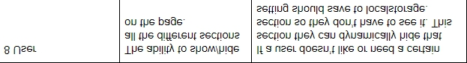
Future Development
One of the user stories we originally included was the ability for users to remove specific areas of the page based on preference and those preferences saving into local storage for later use

Slide 19

Questions

